Slide 1
Angular NgRx
Strongly Typing the State
Lecture 4
By James(Jin) Wang
10/08/2022

Slide 2
Outline
Set up the sample application
Install @ngrx/store
Initialize the Store
Define the State and Actions
Build a Reducer to process Actions
Dispatch an Action to change State
Subscribe to the Store to get State changes

Slide 3
Install Store
  Install @ngrx/store
  ng add @ngrx/store
  Demo: install Store

Slide 4
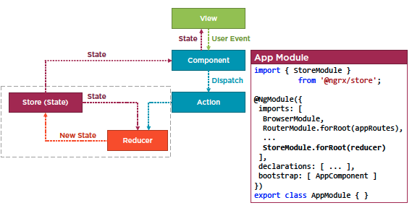
Initialize Store
  Initialize store

Slide 5
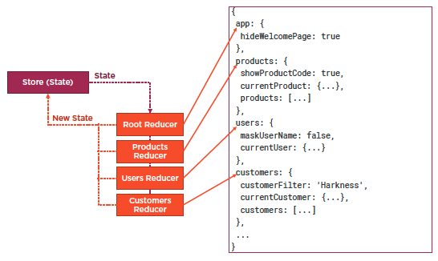
Initialize Store
  Initialize store

Slide 6
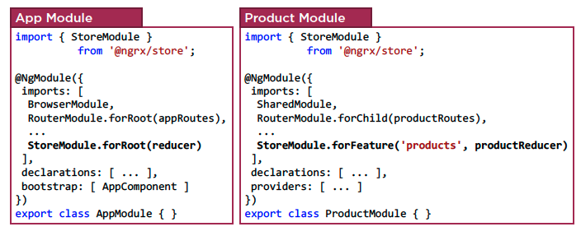
Initialize Store
  Feature Module State Composition

Slide 7
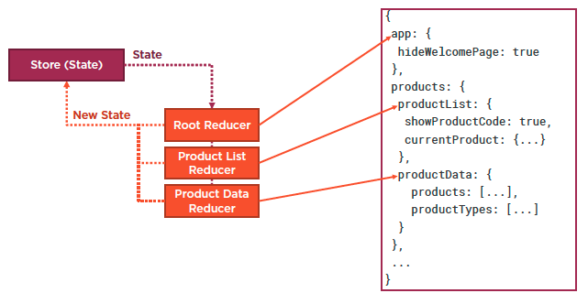
Initialize Store
  Sub-slice of State

Slide 8
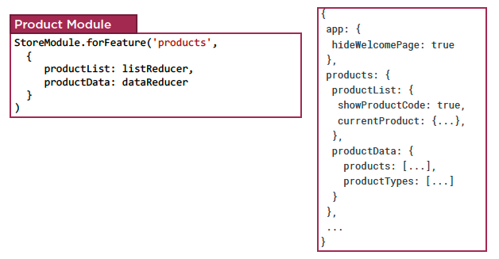
Initialize Store
  Sub-slice of State

Slide 9
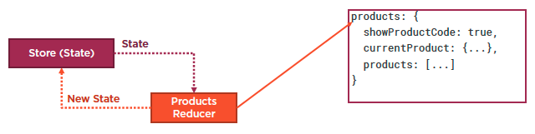
Initialize Store
  Sub-slice of State
  Demo: initialize the Store

Slide 10
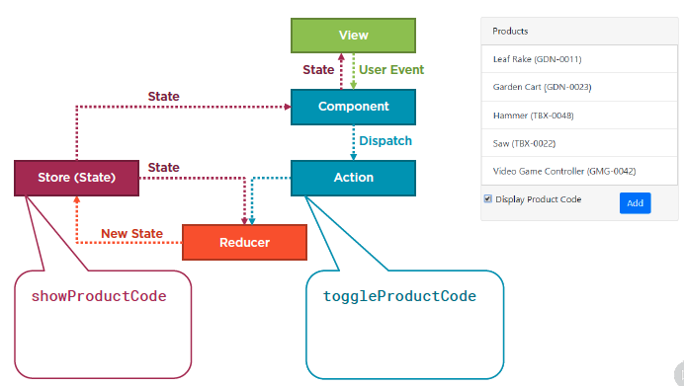
Building a Reducer
  Define the state and actions

Slide 11
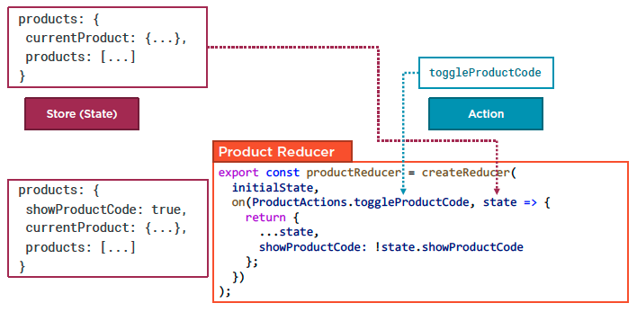
Building a Reducer
  Build reducer

Slide 12
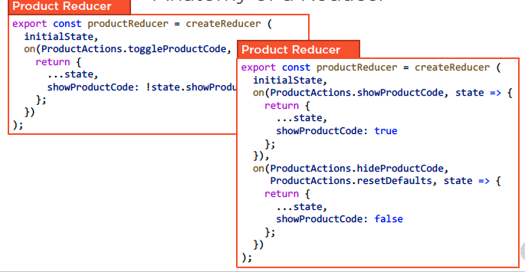
Building a Reducer
  Anatomy of a Reducer
  Demo: build a reducer

Slide 13
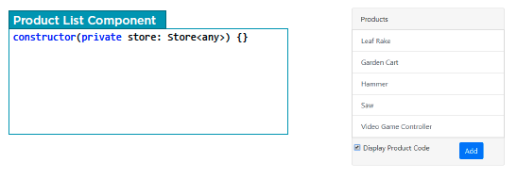
Dispatch an Action
  Dispatch an Action

Slide 14
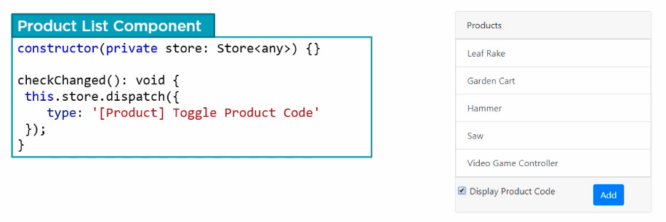
Dispatch an Action
  Dispatch an Action
  Demo: dispatch an Action

Slide 15
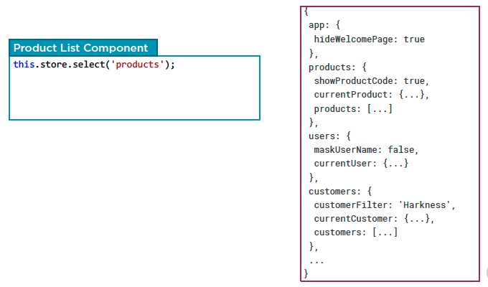
Dispatch an Action
  Subscribe to state changes

Slide 16
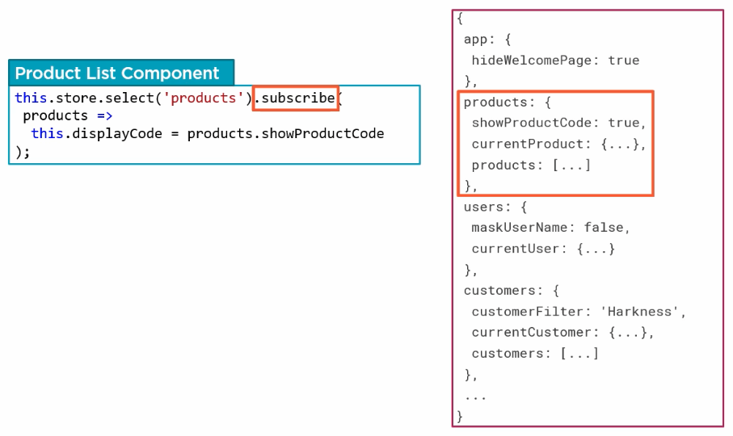
Dispatch an Action
  Subscribe to state changes
  Demo: subscribe to state changes

Slide 17
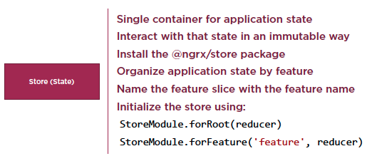
NgRx First Look
  Checklist: Store

Slide 18
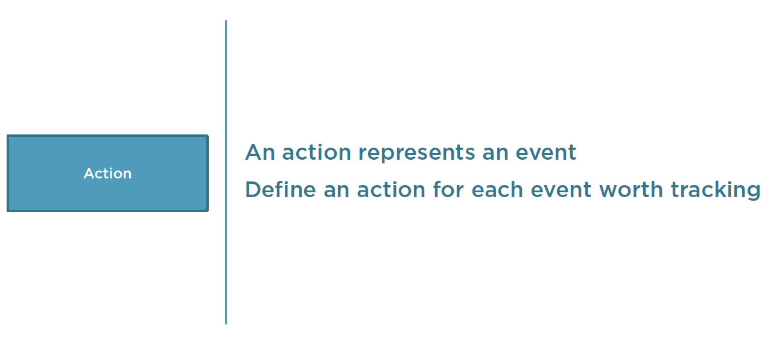
NgRx First Look
  Checklist: Action

Slide 19
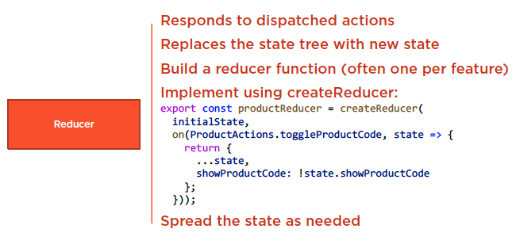
NgRx First Look
  Checklist: Reducer

Slide 20
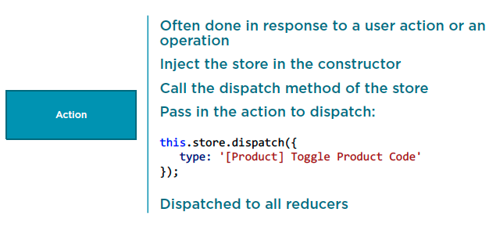
NgRx First Look
  Checklist: Dispatching an Action

Slide 21
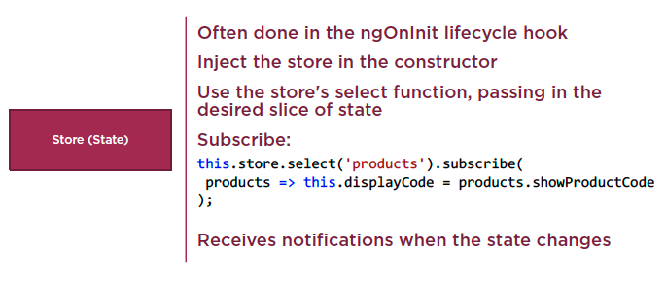
NgRx First Look
  Checklist: Subscribing to the Store

Slide 22
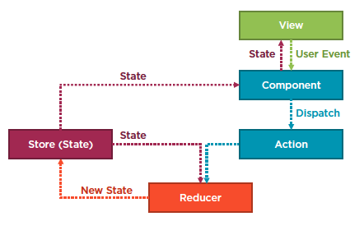
NgRx First Look

Slide 23
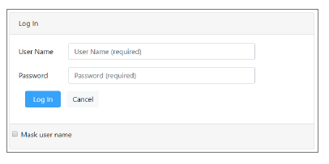
Homework
Login page
Initialize the store in the user module
Define the state and action
Create the reducer function
Dispatach an action
Subscribe to the user slice of state

Slide 24
Reference
Angular NgRx: Getting Started
https://app.pluralsight.com/library/courses/angular-ngrx-getting-started/table-of-contents
Play by Play: Angular and ngrx
https://app.pluralsight.com/library/courses/play-by-play-angular-ngrx/table-of-contents

Slide 25
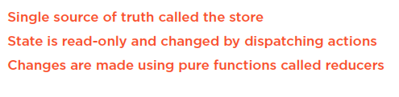
Summary

